Slide 1
Random Numbers, Distribution and Transformation
2021 Data Camp
<number>

Slide 2
What is random number?
Random numbers are sequences of independent numbers with a specified distribution such as uniform distribution, normal distribution and exponential distribution, etc. (We will talk about what is distribution in later slides)
Random numbers have been used for a long time. The goal is to leave the result up to random chance. For instance, rolling a dice and flipping a coin.
2

Slide 3
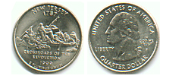
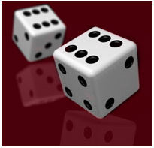
Experiments
Coin Flipper
https://www.random.org/coins/
http://www.shodor.org/interactivate/activities/Coin/
What do you expect to see if we flip a coin 1,000 times?
Dice Roller
https://www.random.org/dice/
http://www.roll-dice-online.com/
What do you expect to see if we roll a dice 1,000 times?
2

Slide 4
What is random number generator?
Random number generators are just the modern application of randomness devices such as dice and flipping coins.
In modern computing, random number generators are implemented through programming based on deterministic computation. Therefore, this is not really considered as true random.
In practice, this is sufficient to fulfill most tasks.
2

Slide 5
Use python to generate random numbers
Switch to Python…
2

Slide 6
Distribution
As we mentioned in the first slide, random numbers are sequences of independent numbers with some specified distribution. We now give the formal definition of distribution:
A probability distribution is a mathematical function that provides the probabilities of occurrence of different possible outcomes in an experiment.
Discrete distribution
Continuous distribution
For instance, if X is used to denote the outcome of a coin toss ("the experiment"), then the probability distribution of X would take the value 0.5 for X = heads, and 0.5 for X = tails (assuming the coin is fair).
6

Slide 7
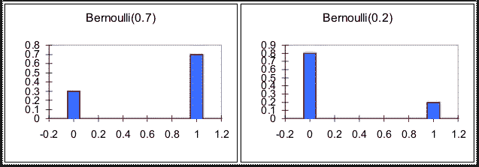
Some common distributions
Discrete Distribution
Bernoulli distribution
(Definition) The Bernoulli distribution has only two possible outcomes like success and failure with success probability p and failure probability 1-p.
The distribution of heads and tails in coin flip is an example of a Bernoulli distribution with p=?
7

Slide 8
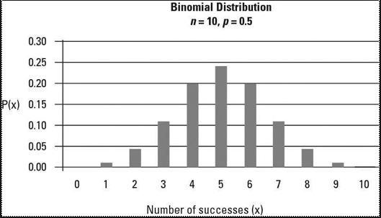
Some common distributions
Discrete Distribution
Binomial distribution
(Definition) Only two (mutually exclusive) outcomes are possible, such as gain or loss, head or tail, success or failure, yes or no. If the probability of success in any given trial is known, binomial distributions can be employed to compute a given number of successes in a given number of trials.
What distribution does the number of heads in 100 coin flips follow?
8

Slide 9
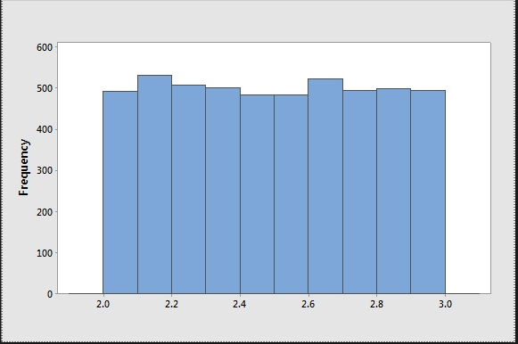
Some common distributions
Continuous Distribution
Uniform distribution
(Definition) A continuous random variable has a Uniform distribution if its values are spread evenly over the given range of an interval.
Note: the graph of a uniform distribution results in a rectangular shape.
9

Slide 10
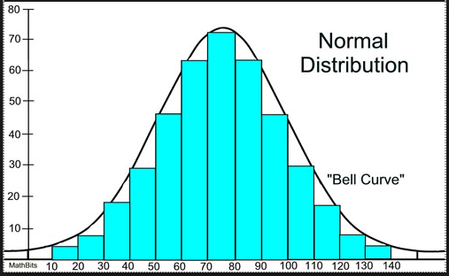
Some common distributions
Continuous Distribution
Normal distribution
(Definition) A continuous random variable has a Normal distribution if most values cluster in the middle of the range and the rest taper off symmetrically toward either extreme.
Note: the graph of a uniform distribution results in a bell shape.
10

Slide 11
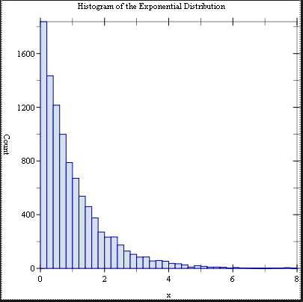
Some common distributions
Continuous Distribution
Exponential distribution
(Definition) The exponential distribution is often concerned with the amount of time until some specific event occurs. There are fewer large values and more small values.
Note: the graph of a uniform distribution results in an exponential decay curve.
11

Slide 12
Use python to generate distributions
Switch to Python…
11

Slide 13
Transformation
In practice, we can generate random numbers of a different distribution by doing math transformation of the random numbers of an existing distribution.
For example, We can generate exponential distribution from uniform distribution.
Show example in Python
The proof of why transformation works require some knowledge of probability theory, we will omit the proof here.
13

Slide 14
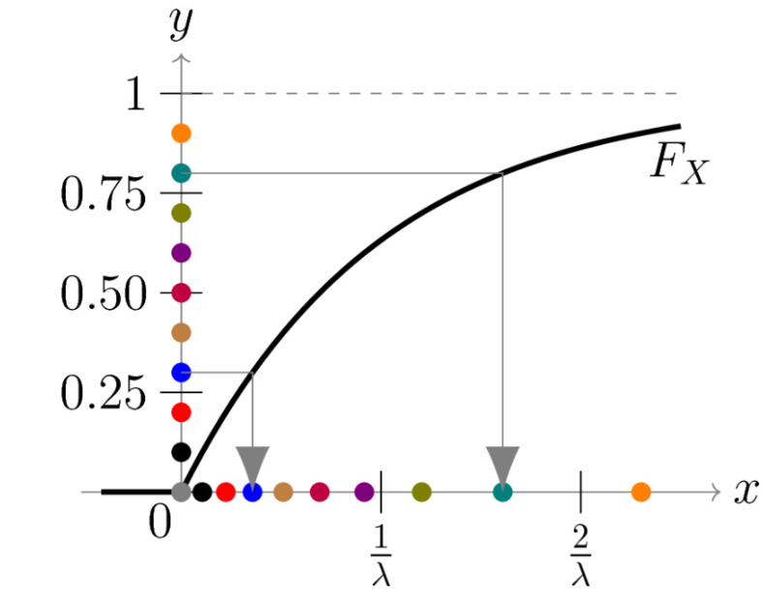
Transformation
Transform uniform distribution to a non-uniform distribution
14

Slide 15
Practice
Switch to python…
14

Slide 16
Questions
Preparation for GAN
How computer learn to recognize objects instantly: :https://www.youtube.com/watch?v=Cgxsv1riJhI
How we teach computers to understand pictures: https://www.youtube.com/watch?v=40riCqvRoMs
<number>

